Slide 1
OCA
The Open Control Architecture
The OCA Alliance
www.oca-alliance.com

Slide 2
You can easily move a signal from A to B, but what are you going to do with it when it gets there?

Slide 3
MEDIA
NETWORK

Slide 4
PROGRAM
TRANSPORT

Slide 5
SYSTEM
CONTROL

Slide 6
Why another control standard?
OCA is the only control architecture that is all of the following:
  Pro application oriented
  Scalable up to huge network sizes
  Suitable for mission-critical applications
  Compatible with proprietary product features
  Futureproof
  Secure
  On track to become an open public standard.

Slide 7
OCA In Action: Concert tour
Concert tour sound system
Touring system, possibly incorporating equipment from prime contractor and various subcontractors.
Multiple ad-hoc connections, varying from place to place, ideally using network audio. For example:
  Prime contractor provides main loudspeakers, subcontractors provide delay systems, fills, woofers, etc.
  Connected to resident venue system for area fill.
  Connected to show video systems, radio, TV,& internet broadcast systems, recording systems, & press.
System configured modularly, with multiple mix and loudspeaker/ amplifier subystems, variously deployed from rental house(s) for different tours.
Media transport may be mix of Ethernet, AES3, MADI, AVB, Dante, etc.
OCA
Benefits
Central wired & wireless control of multiple network(s).
Multivendor support. High reliability. Media flexibility.

Slide 8
OCA In Action: Large Install Venue
Large installed sound system
Example: stadium, multipurpose arena, large auditorium
Multiple program sources, control stations, loudspeaker clusters, and external interfaces.
Interfaces to paging, signage, security, emergency (fire), show video, security, and other internal systems.
Interfaces to external systems - broadcast, internet, user devices (tablet, smartphone).
Evacuation standards compliance may be required.
Security may be required.
Network infrastructures are typically administered by central IT.
Large to very large network diameters.
OCA
Benefits
Control of large & complex networks. Security. Public standards compliance for Evac. Multivendor systems.

Slide 9
OCA In Action: Broadcast Intercom
Network Broadcast Intercom System
Example: major television network production intercom
Thousands of intercom stations, multiple control points.
Transcontinental networks using private leased data lines.
Interfaces to broadcast mixing equipment.
VoIP interfaces
Portable and fixed-location stations.
Many subnets - multiple sites, multiple work environments within buildings, multiple remote locations.
Network infrastructures may be administered by production intercom departments or by central IT.
Frequent reconfiguration.
Critical function - must not fail (millions of dollars at stake)
OCA
Benefits
High reliability. Much simplified cabling. Ability to use
corporate network(s). Multivendor systems.

Slide 10
OCA In Action: Bar Band
Tiny Sound System for Small Music Acts
Single media network connecting everything
Four house speakers, two stage monitors, mixers, mics, ancillary gear
In-ear monitoring system optional
Powered loudspeakers, network-connected
One main house mixer, tablet-based (no big mixing desk)
Onstage monitor mixers for each musician - small tablets on mic stands
Wired microphones connect through stage box on network
Wireless microphones connect through receiver(s) on network
In-ear monitors connect through transmitter(s) on network
Wireless access to main house mix is an option
Optional external interfaces, both analog and digital, to house systems
Optional multitrack digital recorder on network
Optional webcasting interface on network and on internet
OCA
Benefits
Much simplified cabling. Improved diagnostic functions/features. Easy reconfiguration.

Slide 11
A Peek Under the Hood

Slide 12
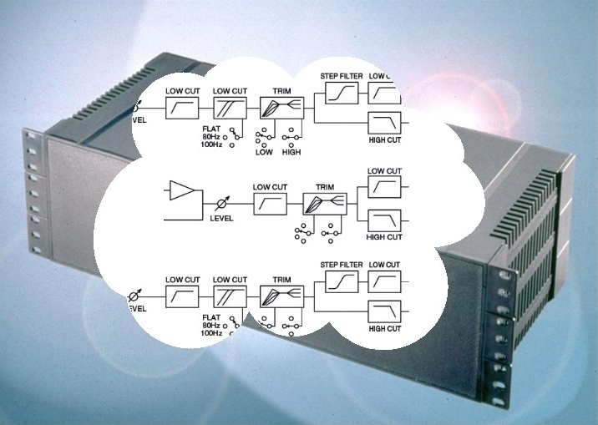
OCA Device Model
Box of Objects

Slide 13
OCA Control Repertoire (v.1.1)
Gain controls
Mutes
Switches (n-position)
Delays
Equalizers
Filters (IIR & FIR)
Limiters & Compressors
Expanders & Gates
Levelers
Matrices
Signal generators
Arbitrary numeric parameters
Level sensors (meters)
Frequency sensors
Time interval sensors
Temperature sensors
Grouping (~VCA groups)
Crossfading
Media connections & routing
Proprietary extensions

Slide 14
OCA Network Traffic
Includes
meter updates

Slide 15
Status & Plans

Slide 16
OCA Standardization Strategy

Slide 17
Alliance formed
OCA 1.2 Spec
OCA 2.0
Spec
AES
X210v1
Std
AES
X210v2
Std
OCA Products

Slide 18
The OCA Alliance
Attero Tech
Audinate
Bosch Communications Systems
d&b audiotechnik
Duran Audio
LOUD Technologies
Presonus
RCF spa
Salzbrenner Stagetec Mediagroup
TC Group
Waves Audio
Yamaha Corporation
2013.01.29

Slide 19
Get with OCA
Use OCA in your products
Participate in AES X210 standards work
Join the Alliance

Slide 20
www.oca-alliance.com

